Slide 1
Build Android native apps with the Microsoft Graph Java SDK
Implement Azure AD authentication to Android applications

Slide 2

Building Microsoft Graph applications
Authentication overview
Azure AD
App Registration portal
Implementing MSAL in Android apps

Slide 3
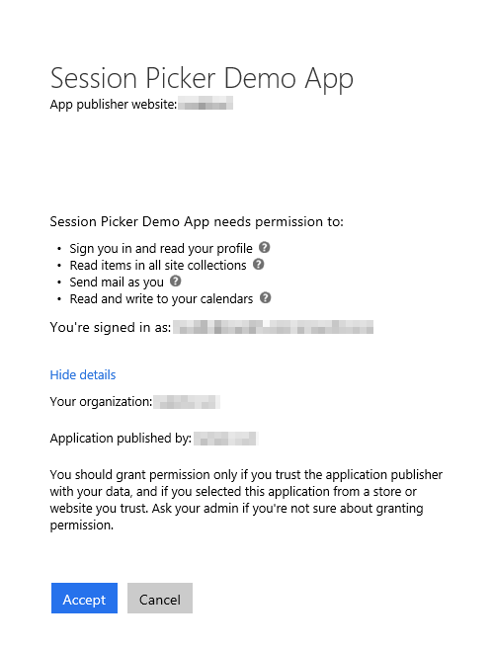
Azure AD OAuth in Microsoft 365
Single authentication flow
Across all Office 365 services
“Native” apps and web sites
Admin and end-user consent
Secure protocol
OAuth 2.0 (no capturing user credentials)
Fine-grained access scopes
Supports MFA and federated user sign-in
Long-term access through refresh tokens
Unique considerations of “Native” Azure Apps
Inherently multi-tenant
No client/app secret (think about distribution)
Leverage a web authentication window/broker
Notes:
All Office 365 cloud services, including SharePoint Online, and Microsoft Graph, leverage Azure AD for authentication and authorization
This means there is a single authentication flow to use Office 365 applications as well as those created to leverage the Microsoft Graph

Slide 4



OAuth basics
OAuth client (native or web app)
Resource Server (REST API)
Access data
Bearer token
Access service
Delegate AuthN/AuthZ
Issue token
Grant access
Resource owner (end user)
Authorization server
Notes:
Every scenario has these basic parts. There are various implementations, but the premise is the same for all.
Both the client and the resource server need to know about the authorization server, in this case Azure AD.

Slide 5

Endpoint versions
v1
Microsoft account
Azure Active Directory v2.0 endpoint
Converged authentication accepts sign in from both Microsoft personal accounts and Azure AD work and school accounts.
Enables the same code for using Microsoft Graph for things like reading mail or retrieving contacts.
Dynamic consent, requesting permissions when you need them.
Additional Microsoft Graph capabilities for AAD users such as SharePoint and Microsoft Teams.
Azure Active Directory v1 endpoint
Enables access to Azure protected resources
v2
v1
Azure Active Directory
http://aka.ms/aadv2
AD
AD
AD
Notes:
The v2 endpoint includes breaking changes to protocols.
This is why it is the V2 endpoint. Because the protocol is different, requires new client library implementations.

Slide 6
Key improvements v2.0 versus v1
scope instead of resource parameter for interop
v1: resource=https://graph.microsoft.com
v2: scope=https://graph.microsoft.com/User.Read or scope=User.Read
Dynamic instead of static consent for incremental consent
id_token claims updated to OpenID Connect standard
Single app registration to represent native and web application combination
Well-known OpenID scopes
offline_access – Enables retrieving refresh tokens
openid – Allows your app to sign the user in and receive an app-specific identifier for the user
email – Allows your app access to the user’s primary email address via the email claim in the token
profile – Allows your app access to all other basic information such as name, preferred username, object ID, and others.
https://docs.microsoft.com/en-us/azure/active-directory/develop/active-directory-v2-compare
Notes:
In v1 endpoint, had to provide resource parameter to identify which resource you were requesting an access token for. Open source libraries were not able to easily incorporate into requests. Now use the scope parameter, which is supported by all libraries, to compound the resource and permission.
When you build applications with AADv1, had to register what permissions the application needed, and user consented to all permissions statically. With AADv2, can now send scopes you want at the time you want them, don’t need to ask for all of it up front.
Changed contents of id_token to better conform to Open ID Connect 1.0 specification, such as using preferredUserName claim instead of UPN claim. The most
In the past, if you needed a client app, single page app, web app, and web API, you had to create multiple registrations and wire up the relationships between them. AAD v2 now enables one registration across a single logical application.
For more information: https://docs.microsoft.com/en-us/azure/active-directory/develop/active-directory-v2-compare

Slide 7
SDKs
Microsoft Authentication Library (MSAL)
Targets v2.0 endpoint
New conceptual model
PublicClientApplication
ConfidentialClientApplication
Multiple platforms
MSAL.NET - .NET Client, Windows Store, UWP, Xamarin, iOS, and Android
MSAL.js – JavaScript
MSAL for ObjectiveC – iOS and macOS
MSAL for Android – Android
Azure Active Directory Authentication Library (ADAL)
Targets v1 endpoint
Notes:
As there are changes in the protocols between v1 and v2, this requires a change in the SDK and a new conceptual model.
PublicClientApplication uses the registered application ID. ConfidentialClientApplication has a secret (clientSecret or x.509 certificate).
MSAL is considered the successor to ADAL. This course focuses on MSAL and the AAD v2 endpoint with Microsoft Graph.

Slide 8
Azure Active Directory Admin Portal
Azure AD Portal
https://aad.portal.azure.com
Login using Microsoft Account (MSA) / Azure AD account (work or school)
Create Azure AD apps that use the v1 or v2 authorization endpoint
Use Azure AD’s ADAL / MSAL SDK for authentication

Slide 9
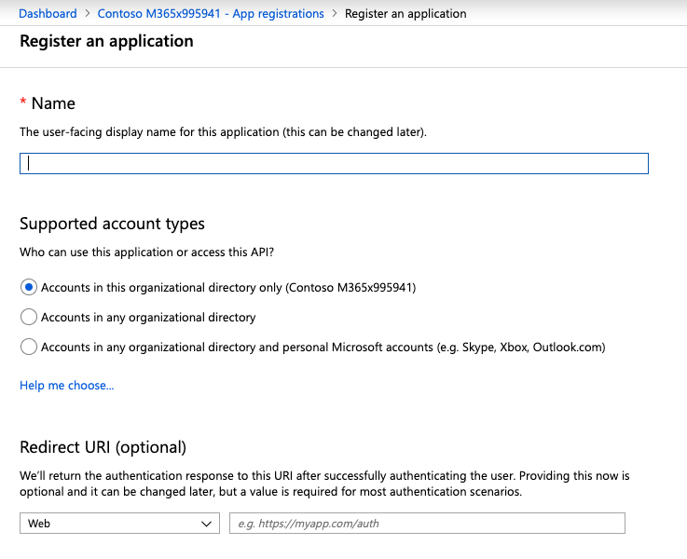
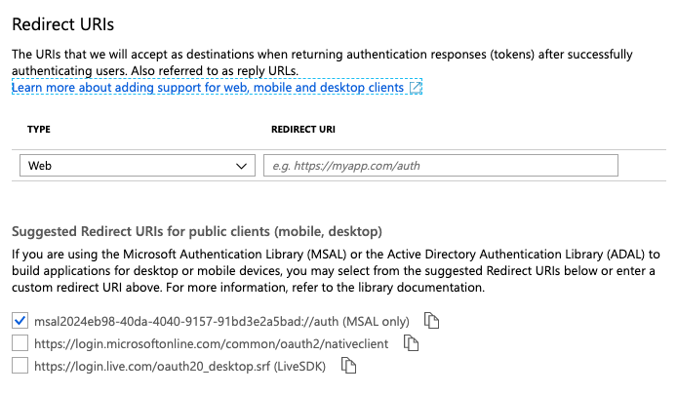
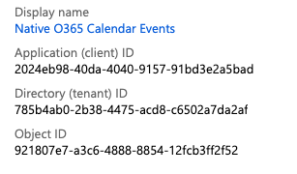
Azure AD Admin Portal
Create the application using the Azure AD Admin Portal
Copy the application’s ID
Add a native application platform to the app
Notes:
For Microsoft Graph apps, it’s recommended to use the Azure AD v2 authorization endpoint
Therefore you will use the Azure AD admin portal
Create the application
Copy the Application ID
Add a new Native application and add the necessary permissions

Slide 10
Implementing Azure AD Authentication for Android apps

Slide 11
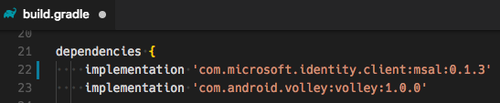
Add Azure AD’s MSAL Android SDK to the App
Azure AD provides an Android implementation of the Microsoft Authentication Library (MSAL)
Add to the project using Gradle (build and package manager)
MSAL handles integration with Android to use the default browser to display the Azure AD login & delegated consent experience
Notes:
The Azure AD team provides an Android SDK for native Android applications
Add this to your project using Gradle
Gradle is a build & package management tool commonly used in Android development
Similar to MSBuild + NuGet in a .NET project
Also add the Volley library, a HTTP networking library

Slide 12
Demo

Slide 13
Thank you.

